Slide 1


Gizmos Electronics Pvt. Ltd.

Slide 2
OUR TEAM
Krishan Chawla
Aditya Jain
Astha Dogra
Disha Khanna
Prachi Shukla
Sukanya Agarwal
Sumit Manchandani
Shubham Karwal

Slide 3
OUR TEAM
Krishan Chawla
Aditya Jain
Astha Dogra
Disha Khanna
Prachi Shukla
Sukanya Agarwal
Sumit Manchandani
Shubham Karwal

Slide 4
PROBLEM STATEMENT
In the fast moving world, the need to get things done fast is becoming more essential.
Currently there are electronic registrars and employees doing the selling process, using barcode scanning and pay by credit cards.
Nevertheless these customers have to wait in queues in most cases:
Too many customers at the same time
There is not enough employees to do the job
Online shopping system is for the remote shopping or shopping through internet.
We are providing an easy way to the customers for shopping by just browsing through the internet and then adding them to the cart following the order payment either by ‘cash on delivery’ or by ‘debit card’.

Slide 5
TECHNOLOGIES USED
Oracle Database 10G
Hibernate 4
REST Services
Spring MVC
Javascript
Angular JS 1.x
Bootstrap 3.3.7
jQuery 3.3.1

Slide 6
SCOPE
IMPLEMENTED
User
Login & Register
View Products
Search Products
View Product By Category
Add to Cart
Buy Product
Admin
Insert Product
Delete Product
View Product Table
View Order Table
View Customer Table

Slide 7
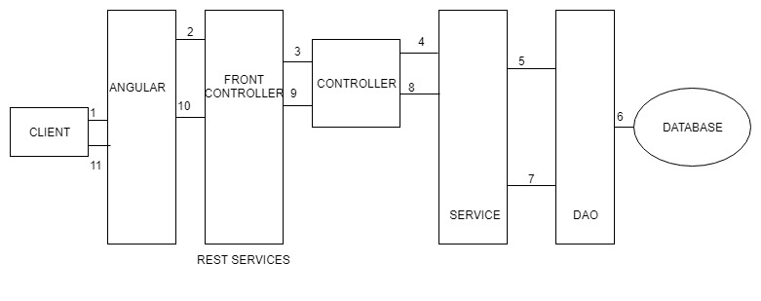
ARCHITECTURE

Slide 8
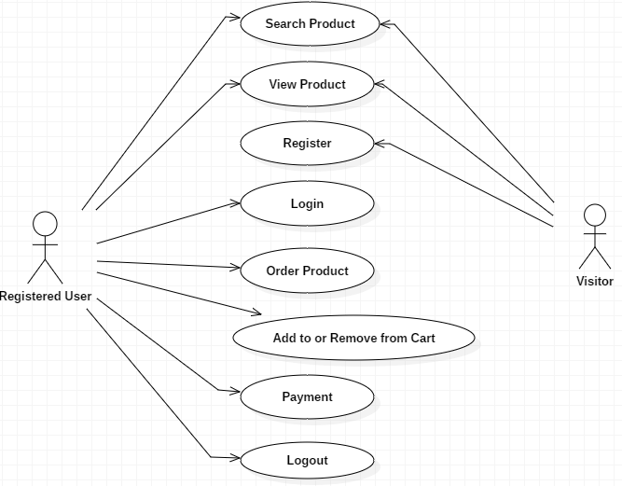
UML DIAGRAMS
Use Case

Slide 9
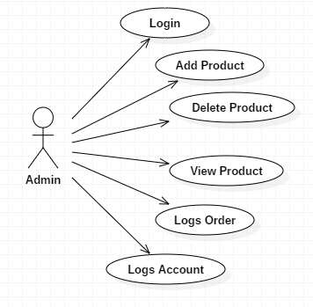

Slide 10
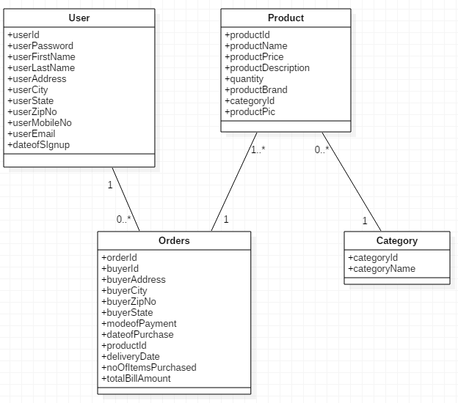
Class Diagram

Slide 11
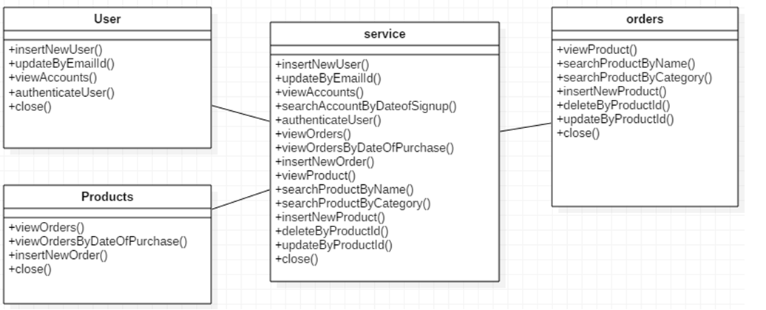

Slide 12
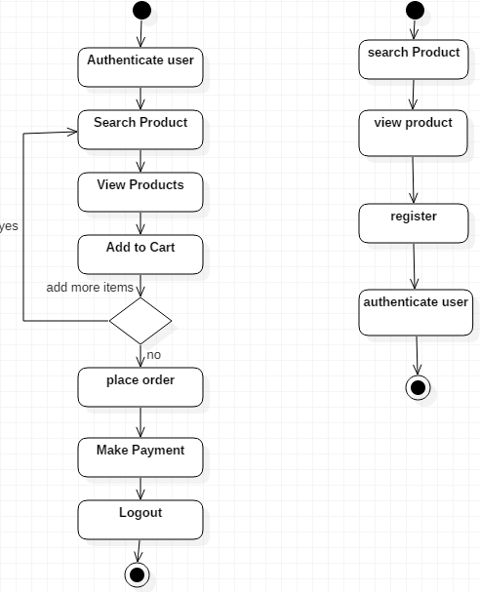
Activity Diagram

Slide 13
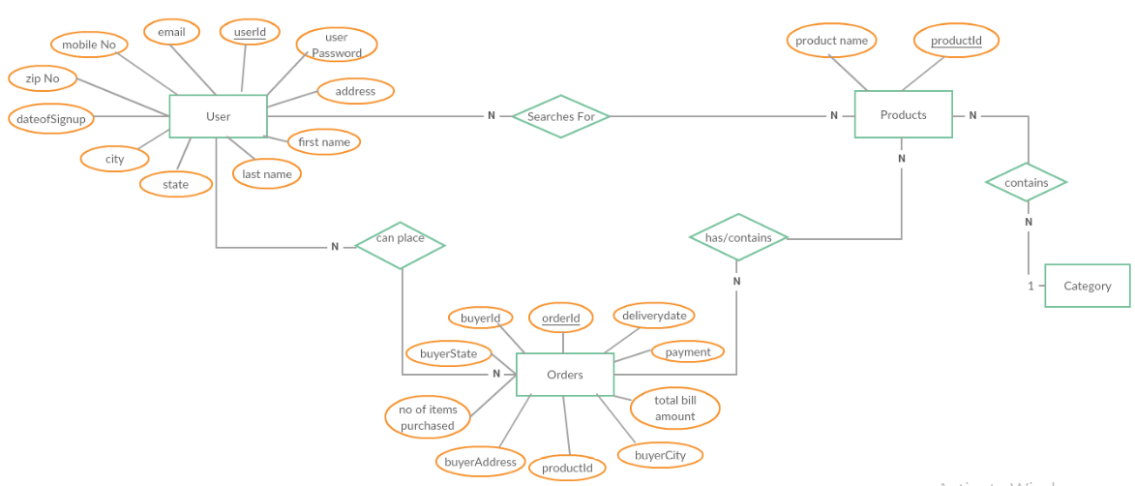
E R DIAGRAM

Slide 14
THANK YOU

